Slide 1



Youth Alive
Reducing at risk Behavior
6th AAIM Tri-Divisional HIV/AIDS Advisory
Nairobi, Kenya
September 10, 2013
By
Kathleen Kiem Hoa Oey Kuntaraf, MD, MPH
Associate Director for Prevention
General Conference Health Ministries Department

Slide 2
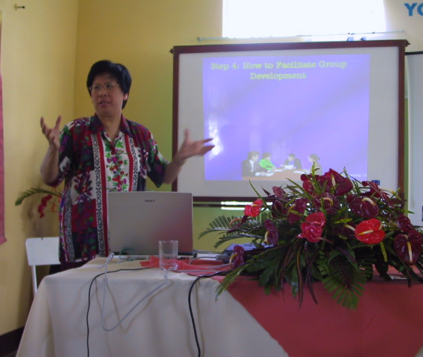
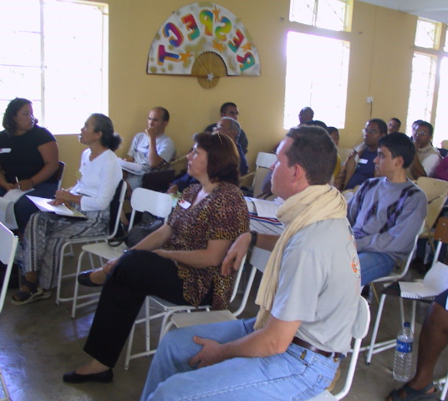
Welcome!

Slide 3
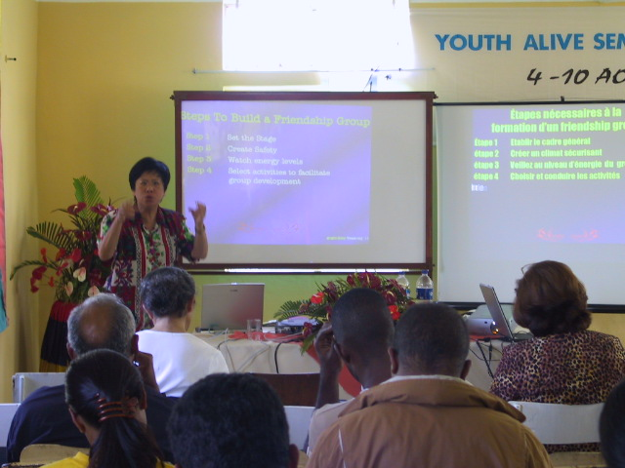
Presentation
will provide you with
information on how a comprehensive prevention approach, to youth’s at-risk behavior problems, works best

Slide 4

US Bureau of Justice Statistics
2002
National Crime
Victimization Survey
Law Enforcement Management & Administrative Statistics
Federal Justice Statistics Program
National Judicial Reporting Program
State Court Processing Statistics
National Survey of Prosecutors
National Prisoner Statistics
Census of State & Federal
Correctional Facilities
Census of Jails
Survey of Inmates in Local Jails
Surveys of Inmates in State Correctional Facilities/Federal Correctional Facilities
Survey of Adults on Probation
Annual Probation Data Survey & Parole Data Survey
Source book of Criminal Justice Statistics

Slide 5

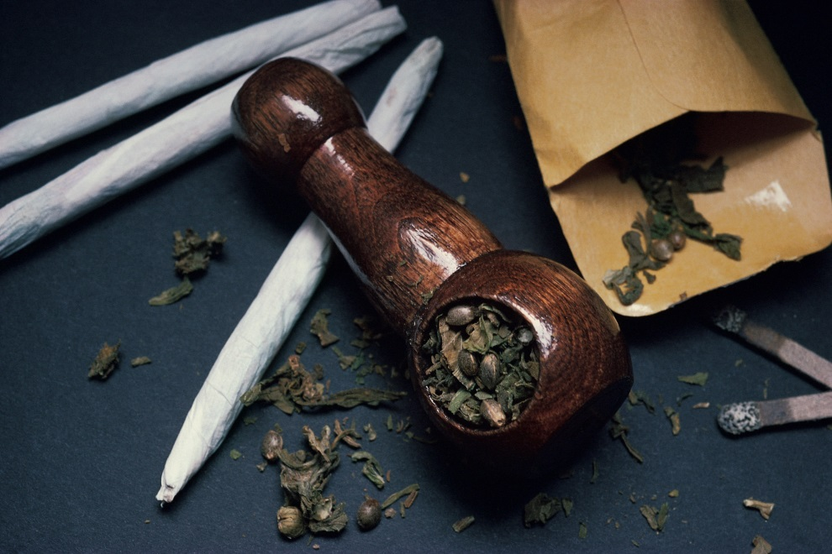
Statistics show
crime related to
Alcohol and other drugs (AOD)

Slide 6
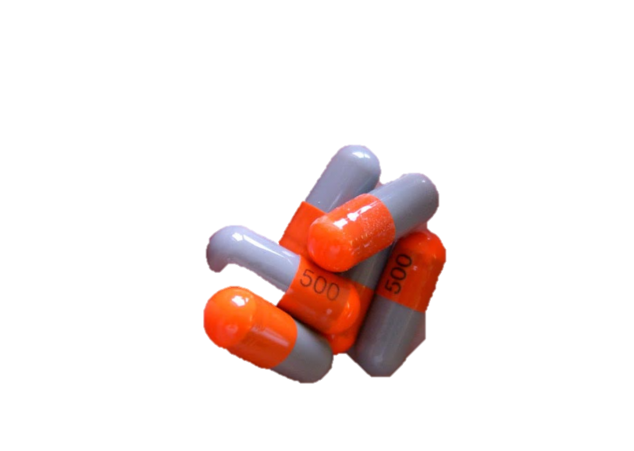


1.2 million violent crimes occur each year
Victims reported offender had been drinking
1 in 4 involved alcohol and other drugs

Slide 7

Probationers Surveyed
(1995)
14% reported being on drugs when they committed their offense

Slide 8

1997 Report
33% State prisoners & 22% Federal prisoners had committed their offense while under the influence of drugs.

Slide 9
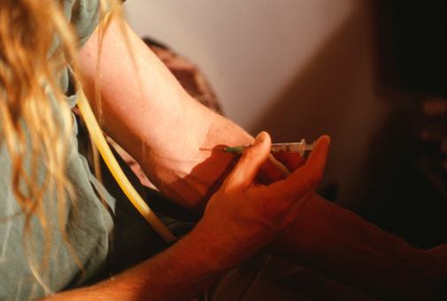
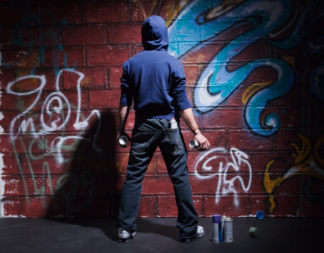
Highest incidence of drug use
42% drug offenders
37% property offenders

Slide 10
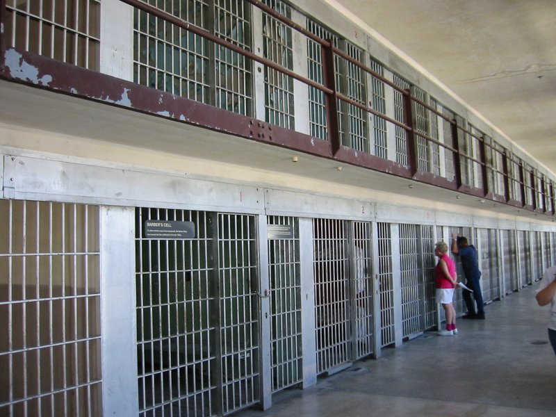
Convicted jail inmates 1998
36% said they were
using drugs at time of their offense

Slide 11
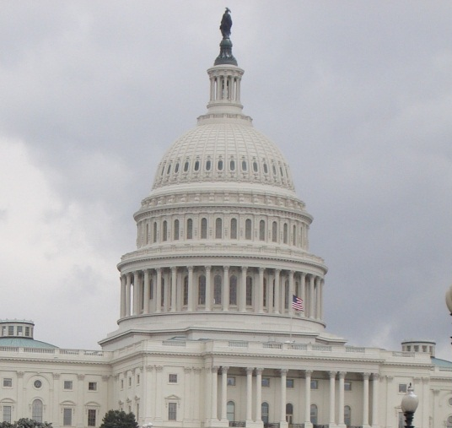
Fiscal year 1999
US Federal, State and local governments spent > $146 billion for civil and criminal justice
8% increase over 1998

Slide 12
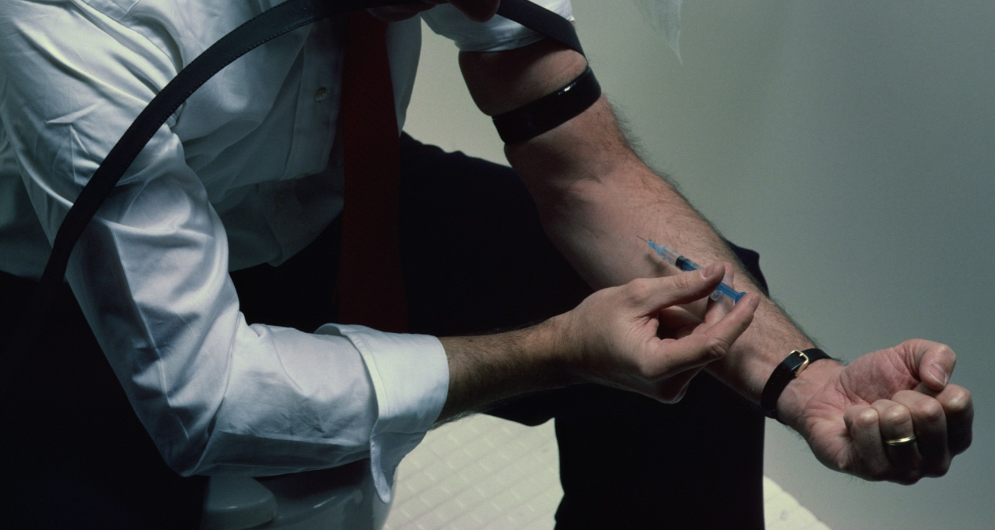
What a devastating impact the use of drugs has!

Slide 13

Cannot put monetary value on human lives & suffering!

Slide 14

Cost of child welfare and court cost needed to arrest, try, sentence, and incarcerate those found guilty of the billion dollars of….

Slide 15



AOD-related offenses, are a tremendous drain on the Nation’s resources

Slide 16
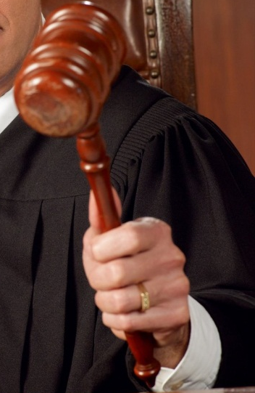


Challenge
Legislation ignores
most dangerous drugs:
Alcohol and Nicotine!

Slide 17


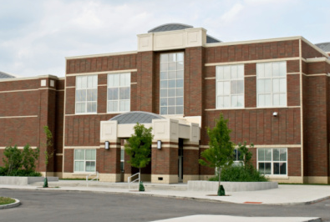
Study done by
Dr. Gary Hopkins and his associates
1994-1995
69 SDA academies in US and Canada

Slide 18
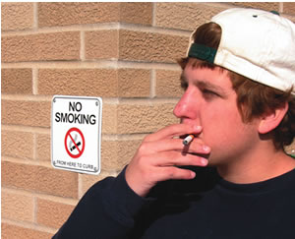

Study by Dr. Gary Hopkins & Associates
Substance Used by Youth
Adventist Youth attending SDA
schools
Non-Adventist Youth
attending public schools
Alcohol
45.7%
81.7%
Tobacco
31%
71.3%
Marijuana
16%
37.2%
Cocaine
3.5%
4.8%
Hard drug (non-Cocaine)
7.6%
18.4%
Injected illegal drug
0.9%
2.4%

Slide 19
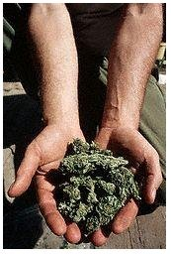
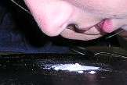
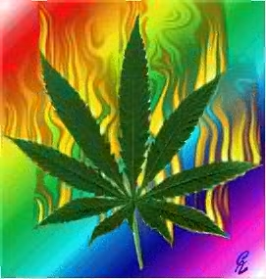
Study by Dr. Gary Hopkins & Associates
Substance Used by Youth
Adventist Youth using drugs
and alcohol before 13 yrs.
Non-Adventist Youth using
drugs/alcohol before 13 yrs.
Alcohol
20.2%
32.4%
Tobacco
13.6%
24.9%
Marijuana
7.6%
12.5%
Cocaine
0.6%
1.2%

Slide 20
Study by Dr. Gary Hopkins & Associates
Adventist Youth and Sexual
Experience (SDA Schools)
Non-Adventist Youth and
Sexual Experience
(Public Schools)
16.3%
53.1%

Slide 21


Realizing Youth
Belong to the youth department
Are in schools that are being supervised by the education department
Have drug problems that are health problems
Belong to a family led by Family Ministries Department

Slide 22
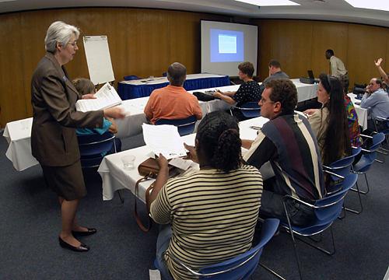
GC’s Youth, Education, Health & Family Ministries departments collaboratively launch the Youth Alive Program
to save our
youth!

Slide 23

Supporting Study
National Longitudinal Study of Adolescent Health
(ADD)

Slide 24
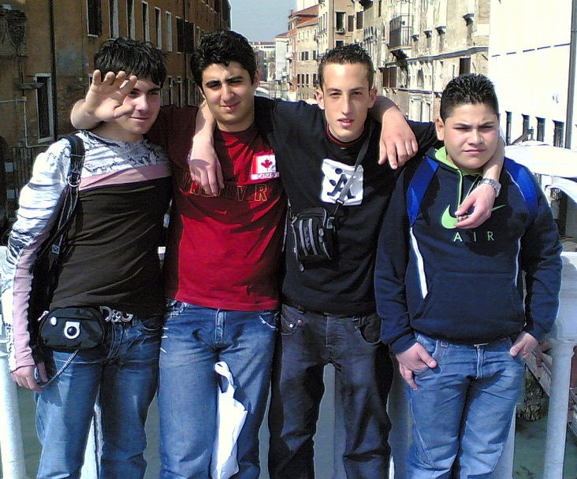
Published in JAMA, 1997
Involved 90,000 teenagers
18,000 parents across U.S.
Provides 2 vital factors protecting children and youth from at risk behaviors

Slide 25

Examples of at-risk behaviors:
Premarital sexual activity
Violence
Suicidal attempts
Drug use

Slide 26
Two vital factors
Factor #1. Getting connected with God
Factor #2. Getting connected with one another

Slide 27
Factor #1

Slide 28
Getting connected with God
When religion and prayer are important
to an adolescent, they are less likely to smoke,
drink or become involved in premarital sexual
activity

Slide 29

Drugs used
Due to significant maladjustments
To escape from problems faced
Ranging from peer pressures to crises at home or in the work place

Slide 30
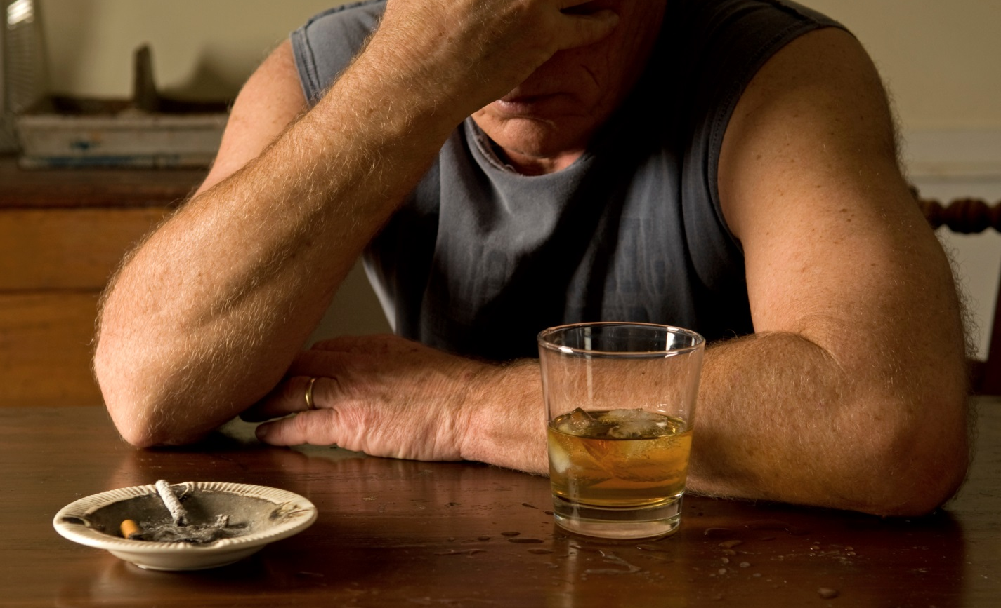
Drug use then is a symptom, not a cause, of personal and social maladjustment

Slide 31
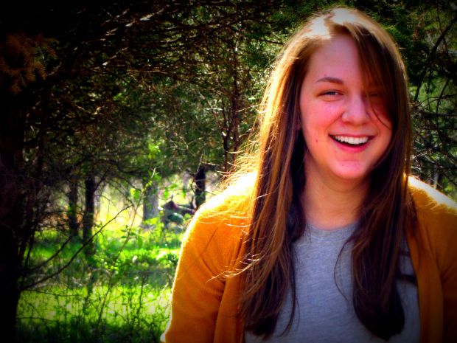
Drugs used to produce psychological dependence
Particularly mood and
sensational altering drugs affecting the central nervous system
Make them feel better than they have ever felt in their lives
- anxiety and tension reduced
- feel elated, euphoric or other pleasurable mood changes
- provide relief from boredom and alleviate pain
- increase mental and physical ability
- provide temporary distortion of reality

Slide 32
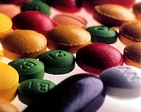
Impact of drugs is powerful ! !

Slide 33

Removing the power of a drug makes people feel “lost”

Slide 34
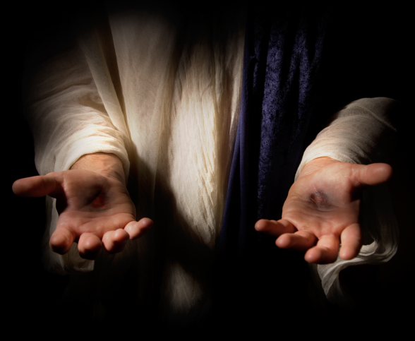
Introduce a power STRONGER than the power of drugs!!
JESUS CHRIST

Slide 35

“I can do all things through him who gives me strength.”
Biblically Supported
Philippians 4:13

Slide 36
Factor #2

Slide 37

Getting Connected with one another
Independent of race, ethnicity, family structure and
poverty status, adolescents who are connected to their parents, to their families, and to their school community are protected from many risk behaviors such as premarital sexual activity, violence, emotional distress, suicidal attempts and drug use.

Slide 38

Man is not an island

Slide 39

Biblically Supported
“For none of us lives to himself, and no one
dies to himself.”
Romans 14:7

Slide 40
Youth Alive incorporates these two important factors!

Slide 41
Youth Alive has five elements
Accurate information
Personal and spiritual growth
Positive social alternatives
Involvement in community change
Leadership activity

Slide 42
Accurate information

Slide 43
Needed to make informed decisions not to use drugs
Can be given in the form of workshops or in the general presentation

Slide 44
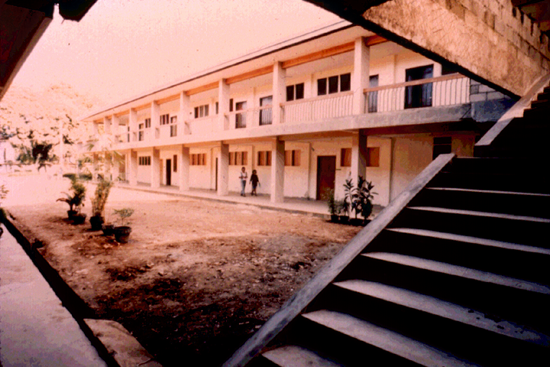
Workshops in Various Classrooms

Slide 45
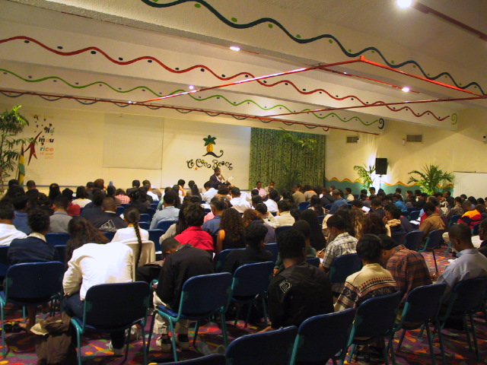
General Session

Slide 46
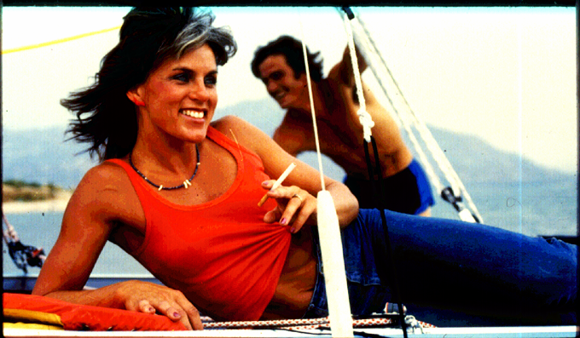

Slide 47
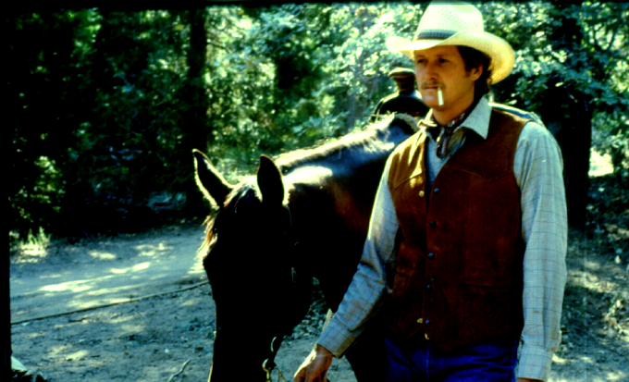

Slide 48


Maryland Study
Joe Camel more recognizable to 6-year-olds
They think he is cool & interesting

Slide 49
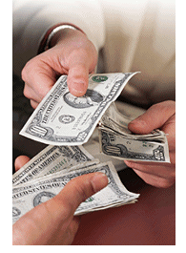
R. J. Reynold Discovered….
Within 3 years of Joe Camel in advertisements
Before Joe Camel - 0.5% smokers <18 years old used Camel brand
After Joe Camel - 32.8% smoking youth use Camel brand
Illegal sales to minors jumped from $6 million to $476 million

Slide 50
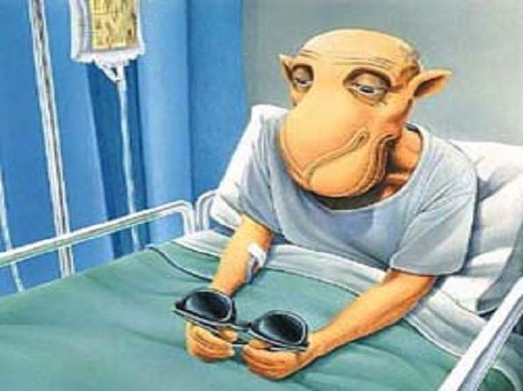
Hospitalized Joe Camel

Slide 51
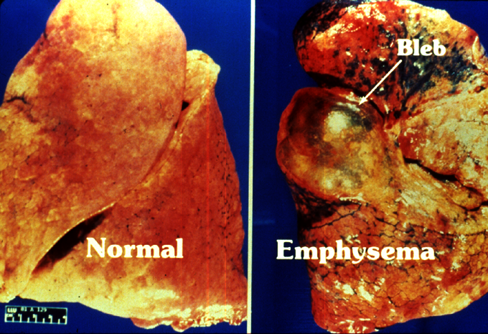

Slide 52
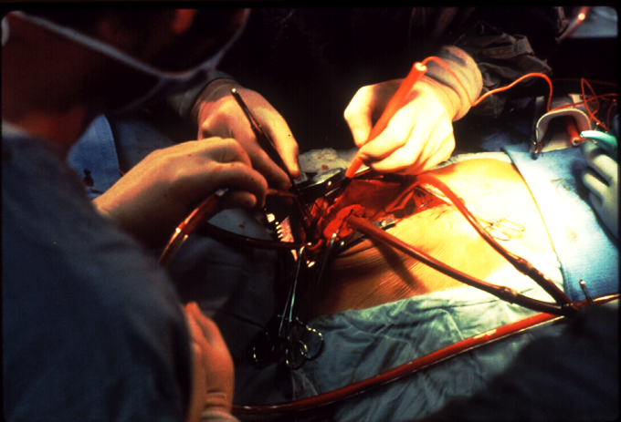

Slide 53
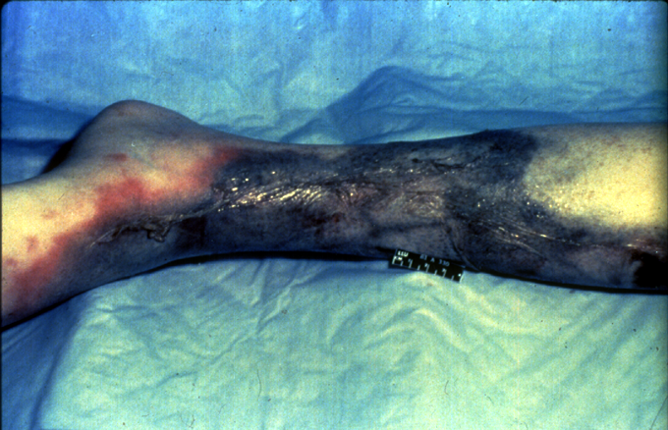
Buerger’s Disease

Slide 54
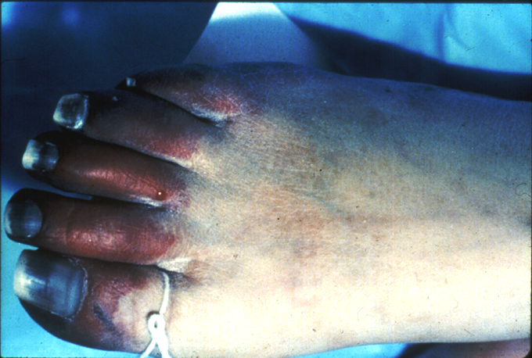
Raynaud’s Disease

Slide 55
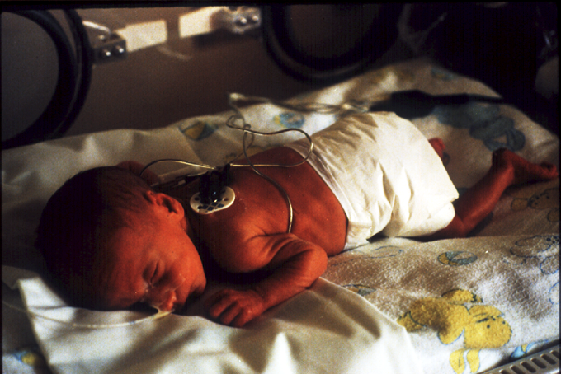

Slide 56
Personal and
spiritual growth

Slide 57
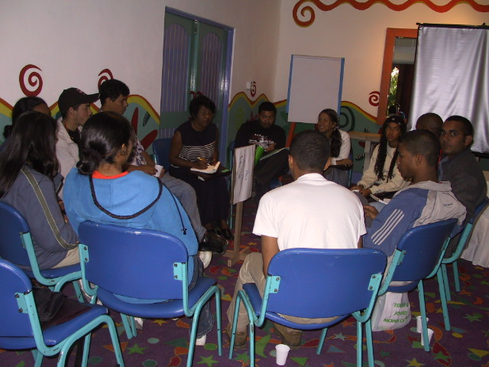
Can be developed in small
Friendship Group (FG) consisting of
10-12 members
Abides by ground rules “no put downs”
Believes in “Honor, Dignity and Respect”

Slide 58
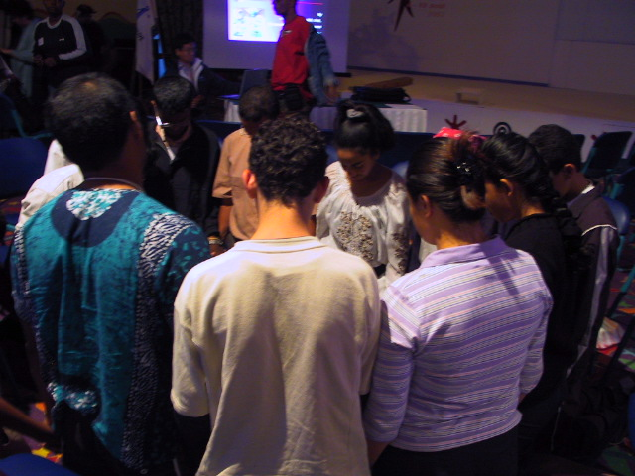
Meeting in a safe environment
FG members feel free to share their problems with one another
FG members encourage one another which results in a real connectedness with one another and with GOD – reduces at risk behaviors!

Slide 59
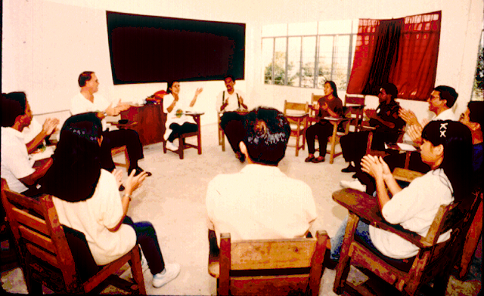
Friendship Group Activities

Slide 60
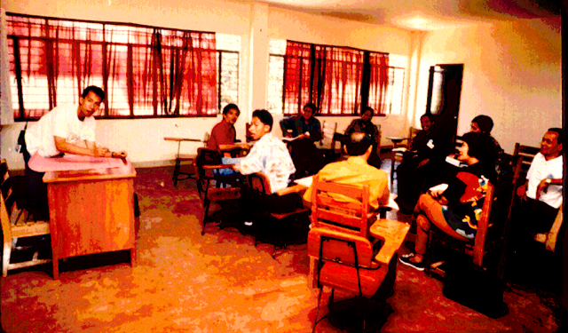
FG Rules

Slide 61
Positive social alternatives

Slide 62
A positive social environment is being established- making connectedness easier to take place !

Slide 63
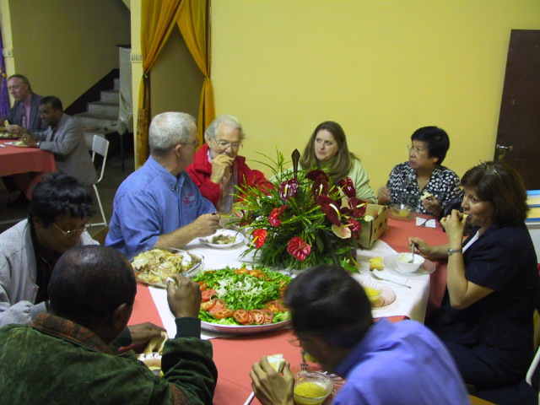
Dining Room Fellowship

Slide 64
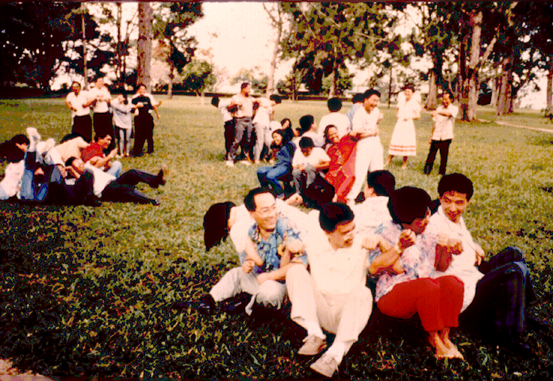
Cooperative Games

Slide 65
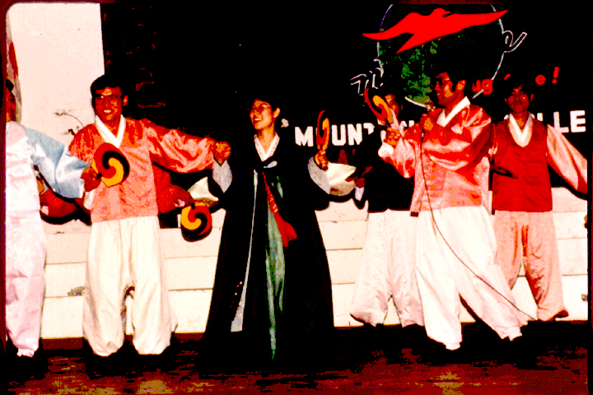
Songs

Slide 66
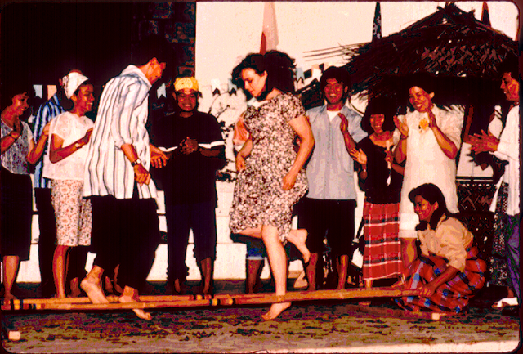
Dances

Slide 67
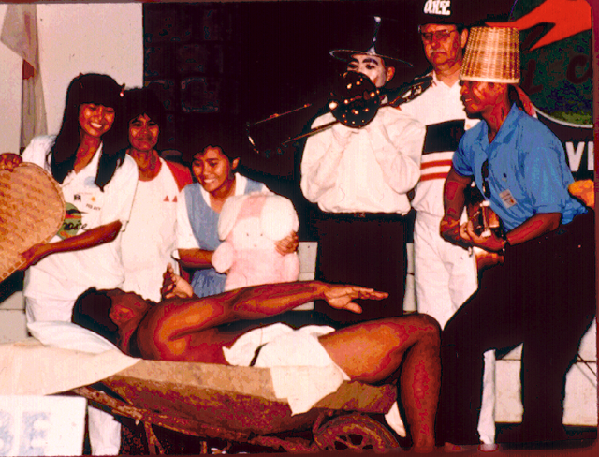
Skits

Slide 68
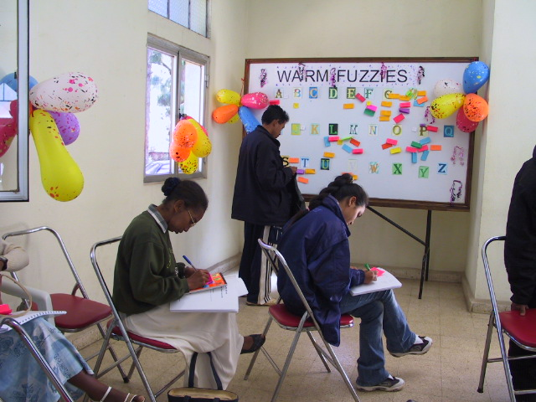
Warm Fuzzies

Slide 69
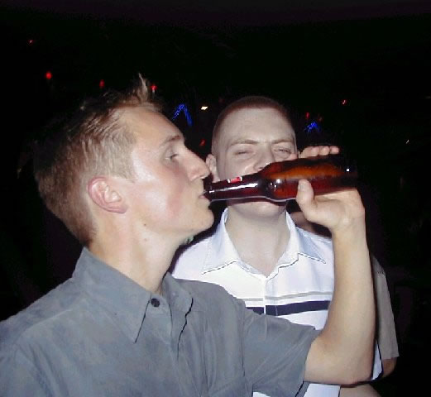
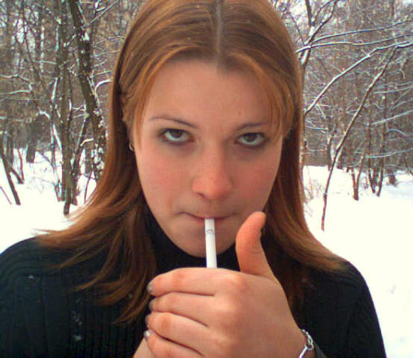
Note:
Misleading to use term positive social “alternatives”
Drugs and alcohol are used as alternatives by people who don’t know how to have fun naturally

Slide 70
Involvement in
community
change

Slide 71
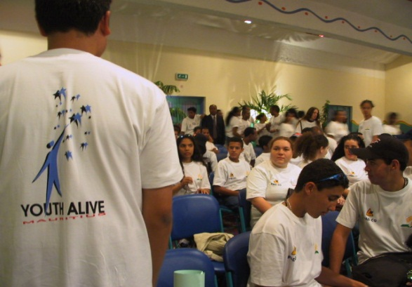
Youth need to be allowed to plan and take responsibility to solve problems in their neighborhood and schools

Slide 72
Leadership activity

Slide 73
Youth need to experience making a difference in their world
They can be actively trained to lead out in the FG or small group activity

Slide 74
Youth Alive Fulfills the Imperatives Recommended by the
Valuegenesis Study
Climate of warmth and openness
Proper understanding of grace
Dynamic, interactive worship experiences that give a sense of God’s love and will for the participants’ lives
Challenging environment promoting individuals to think and learn

Slide 75

“If our churches don’t have an effective youth ministry or programming designed especially for them, coupled with nurturing and caring adults to mentor their faith to the Lord, I believe our congregations will see our youth drifting away from God.”
Bailey Gillespie

Slide 76
Comments from the
Youth Alive
participants

Slide 77

Acceptance of Youth Alive
Americans
Romanians
Russians
Czechs
Germans
Spanish
Italians
Koreans
Chinese
Japanese
Indians
Malaysians
Indonesians
Filipinos
Africans
Mauritians
Madagascans,
Mongolians
Jamaicans
Haitians, etc …

Slide 78
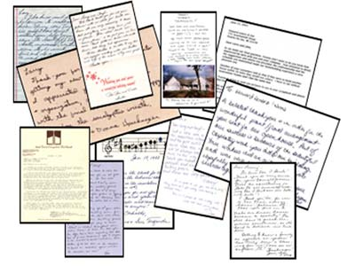
Total negative words
Never exceeded 6% at any conference
94% of the respondents expressed
positive words about the conference!

Slide 79

“Honor, Dignity, & Respect” accepted in all cultures

Slide 80

Adult & Youth Participants’ Responses

Slide 81
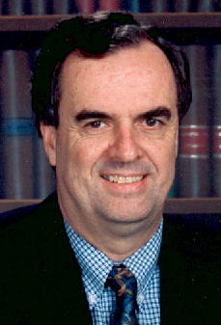
“Through our years at (academy) we have taken lots of students to various types of activities, but none have had the positive impact of Youth Alive. It is unique and effective, and we’re convinced this is the kind of innovative approach we need to meet the needs of our young people in the coming years.”
Adult

Slide 82
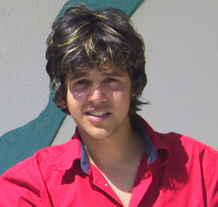
“Youth Alive has helped me so much with my problems. Especially alcohol. It’s hard to give it up and say no by yourself. Youth Alive has given me the hope and courage to go on with life.”
Youth

Slide 83
Responses from parents of students who were greatly pleased with orientation program using Youth Alive principles

Slide 84
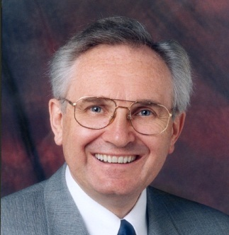
Father
“ Before my son enrolled in the university he was apprehensive about the new environment. Fortunately the orientation program was made using the Youth Alive principles and now he feels greatly connected with his friends.”

Slide 85

Mother
“ My daughter was scared to join the university. Fortunately the school’s orientation program used Youth Alive principles. Now, my daughter has friends from her FG that support her, so she no longer feels lonely. I am truly grateful for this orientation program which made it easier for my daughter to remain in the school.”

Slide 86
Exposures

Slide 87

Divide workshop participants into groups of 4
Name Game
1.
2.
3.
4.
5.
6.
7.
8.

Slide 88
Name Game (pg.25)
Warm Fuzzies
Kind
Karen
Dependable Dan
Caring
Carl
Faithful
Frank
Sweet
Sue
Loving
Linda

Slide 89
“What did you learn from this Name Game?”
Fabulous Fred
Lovely Linda
Dandy Daniel
Cheerful Chantel

Slide 90

It feels good to have a positive adjective before your name instead of being put down!

Slide 91
Imagine being called nice things throughout the conference!
Easier to focus on the positive traits of others!
Operating in a positive environment!

Slide 92
Games Played
To get them bonded with themselves and with God

Slide 93

Trust Walk Game (pg. 28)

Slide 94

TRUST WALK
What did you learn from this Trust Game?
How do you feel being close to the leader?
How do you feel being at the tail-end?
Do you have the same feeling if you are close to God or far away from Him?

Slide 95

Responses may include . . .
“I feel confident being close to
the leader, just
like when I am close to God”

Slide 96

Responses may include . . .
“I feel unsure at the tail end, just
like when I am stressed out and
far from God”

Slide 97

Using “Honor, Dignity and Respect”
They feel connected with God and friends
FG #7, using candles, they feel the
most connectedness with one another
They share their own spiritual story in a very
safe environment

Slide 98

“Warm Fuzzy” (pg.29)

Slide 99
Warm Fuzzies
Kind
Karen
Dependable Dan
Is it easy to give compliments?
Why or why not?
Can you imagine your whole school or community of believers addressing each other in a positive way instead of criticizing one another?
Caring
Carl
Faithful
Frank
Loving
Linda
Sweet
Sue

Slide 100
Every normal human being
Needs to receive warm fuzzies
Needs to receive words of
encouragement
Warm Fuzzies
Kind
Karen
Dependable Dan
Caring
Carl
Sweet
Sue
Faithful
Frank
Loving
Linda

Slide 101


Smithsonian Museum in Washington, D.C.
Has small exhibit containing
Abraham Lincoln’s personal items

Slide 102


Items included:
  Confederate $5.00 bill
  Small penknife
  Broken spectacle case held with a cotton string
  Worn-out newspaper clipping about the President

Slide 103

“Abe Lincoln is one of the greatest statesmen of all time . . .”

Slide 104

Exposing Youth to:
“Warm Fuzzies”
the FG environment
“Honor, Dignity, and Respect” philosophy

Slide 105
Contributes to the
Positive Environment where connectedness and unity among youth and adults takes place easily!!

Slide 106

The need to use drugs to temporarily alleviate problems, is no longer there !

Slide 107

Closing Activities
Spinning A Yarn

Slide 108

Sample of Youth Alive Conference
& Orientation using Youth Alive principles

Slide 109
Suggested
Youth Alive
Conference

Slide 110
Ratio for Training
+
1 adult
1 youth facilitator
for each FG of
10-12 members

Slide 111
Therefore . . .
If there are 500 Youth Alive conference participants, then 100 people are needed to be trained as FG leaders one day prior to the youth congress (50 adults + 50 youth)

Slide 112

Suggested Facilitator’s Training Prior to Youth Alive Conference

Slide 113
Tuesday
08:00 a.m. Breakfast
09:00 a.m. Inspirational Thoughts
09:30 a.m. Getting To Know You
10:30 a.m. Getting To Know Youth Alive
11:30 a.m. Getting Comfortable
12:30 a.m. Lunch
02:00 p.m. Friendship Group Development

Slide 114
Tuesday
06:00 p.m. Supper
07:00 p.m. Planning for Friendship Groups
09:00 p.m. Personal Time
09:30 p.m. Rest Well

Slide 115
Wednesday
08:00 a.m. Breakfast
09:00 a.m. The Adult Role/
09:00 a.m. Youth Facilitators’ exposure to FG Activities
11:00 a.m. Youth Facilitators Rehearsal for Conference
Introduction & “What is Youth Alive?”
12:30 p.m. Lunch

Slide 116

Youth Alive Congress at
Local Educational Institution

Slide 117
Wednesday
08:00 a.m. Registration for
Participants
(Age 14-30 years)
12:30 p.m. Lunch

Slide 118
Wednesday
02:00 p.m. Welcome! Inspirational Thought
Youth Alive Facilitators Introductions
02:30 p.m. Opening Spectacular
03:00 p.m. Get Acquainted Games
04:00 p.m. Friendship Group Session #1
05:00 p.m. “Honor, Dignity, and Respect”
05:15 p.m. “What is Youth Alive?”

Slide 119
Wednesday
06:00 p.m. Supper
07:00 p.m. Musical Concert
08:00 p.m. Personal Time
Colored Clustered Group Briefing
08:30 p.m. Rest Well

Slide 120
Thursday
07:00 a.m. Personal Exercise
08:00 a.m. Breakfast
09:00 a.m. Inspirational Thought
09:30 a.m. General Presentation
Suggestion: Overview of Human
Sexuality
10:30 a.m. Friendship Group Session #2
11:30 a.m. Workshop Series I
12:30 p.m. Lunch

Slide 121
Thursday
02:00 p.m. Friendship Group Challenge
03:00 p.m. Workshop Series II
04:00 p.m. Friendship Group Session #3
05:00 p.m. General Presentation
Suggestion: Getting Smart about
Alcohol
06:00 p.m. Supper
07:00 p.m. Cultural Program
08:00 p.m. Personal time
Colored Clustered Groups’ Briefing
08:30 p.m. Rest Well

Slide 122
Friday
07:00 a.m. Personal Exercise
08:00 a.m. Breakfast
09:00 a.m. Inspirational Thought
09:30 a.m. General Presentation
Suggestion: “Why Not Smoke?”
10:30 a.m. Friendship Group Session #4
11:30 a.m. Workshop Series III
12:30 p.m. Lunch

Slide 123
Friday
02:00 p.m. Cooperative Games
03:00 p.m. General Presentation
Suggestion: Self-Esteem Presentation
04:00 p.m. Workshop Series IV
05:00 p.m. Sabbath Preparation
06:00 p.m. Supper
07:00 p.m. Festival of Songs
07:30 p.m. Friendship Group Session #5
08:30 p.m. Personal Time
09:00 p.m. Rest Well

Slide 124
Sabbath
08:00 a.m. Breakfast
09:00 a.m. “Youth Testimonials”
09:30 a.m. Sabbath School Program
10:30 a.m. Friendship Group Session #6
11:30 a.m. Sermon
12:30 p.m. Lunch
02:00 p.m. Bible Scavenger Hunt

Slide 125
Sabbath
03:00 p.m. Community Outreach Program
06:00 p.m. Supper
07:00 p.m. Friendship Group Session #7
08:00 p.m. Friendship Group Gifts
09:00 p.m. Celebrate Life Drug Free
“Go for it”
10:00 p.m. Personal time
10:30 p.m. Rest Well

Slide 126
Suggestions for
Community Outreach Programs
Tracts Distribution
Witnessing Parade
Puppet Ministry
Sunshine Band in Hospitals/Nursing Homes
Jail Inmate Visitation
Clown Ministries
Door to Door
Feeding the Homeless
Collecting food and clothing for the Red Cross
Singing in parks, etc.

Slide 127
Follow-Up Training Schedule

Slide 128
Sunday
07:00 a.m. Personal Exercise
08:00 a.m. Breakfast
09:00 a.m. Inspirational Thought
09:15 a.m. Colored Clustered Group Meeting
09:45 a.m. Planning for Local
Youth Alive Congress
10:00 a.m. Positive Planning for a Youth Alive
Local Club
12:00 p.m. Lunch
01:00 p.m. Good-bye

Slide 129
Suggested Topics for the
Youth Alive Workshops
Why Abstinence?
Avoiding HIV
Knowing About Drugs
and the Law
Learning about Addiction
Roots of Addiction
Living with Addiction
Collections of Straight Talk from Real Teens about Substance Abuse
Etc.
Sex Communication to Youth (3 hours)
Dealing with Youth Temperaments
Parent Child Dynamics
(3 hours)
Sharing Gospel with
Unique Visuals (3 hours)
Peer Counseling, Etc.

Slide 130

Sample of
Youth Alive Local Club Meeting

Slide 131
Place
Choose a place with rooms for the various FG activities

Slide 132
Time
1 ½ to 2 hours is best for a
complete club meeting

Slide 133
Youth Alive Regular Local Club
Fun
Focus
Friendship Group

Slide 134
Agenda
Fun-Energize and Socialize 15 min.
- Opening/Welcome
- Activities
- Assignment of newcomers to task groups
Focus-Work Time 45 min.
- Have at 3 meetings/month
- 4th week have community outreach activity ending with party!
- Provide regular existing youth programs or pathfinder programs or offer appropriate youth – related seminars, plan projects

Slide 135
Agenda
Friendship Groups 60 min.
- Opening
- Working:
- Discussion on lessons presented in a very practical way
- Sharing our week
- Planning/working activities

Slide 136
Agenda
Friendship Groups 60 min.
- Closing Activity
- Pick up Warm Fuzzies
- Adult & youth facilitators need to provide warm fuzzies to each FG member

Slide 137
Page 1
DATE/TIME
EVENT
PLACE
CONTACT
PHONE
NOTES
Sun. Aug. 20
Early Move In
10:00a
Move
-
In Assistance
Residence Halls
Becky May
3591
-
8:00p
1:00p
Ad Building
Derek Bradfield
6040
-
8:00p
Student Financial Services Open
Mon. Aug. 21
Move In and Act Exam
10:00a
-
8:00p
Move
-
In Assistance
Residence Halls
Becky May
3591
ID Card Station Open
Ad Building
Lois Forrester
3399
9:00a
Student Insurance Open
Deb Hornbacher
3097
-
12:00p
Student Financial Services Open
Derek Bradfield
6040
Student Health Open
Campus Center
Linda Rice
3111
11:30a
-
1:00p
Lunch
Cafeteria
1:30p
Lloyd Erickson
-
5:00p
ACT Exam
Garber Auditorium
3470
5:00p
-
6:00p
Supper
Cafeteria
7:00p
Burman
-
8:00p
Passages Service
Auditorium
Don Murray
3630
8:00p
Lamson Hall
Francie Faehner
6601
-
9:00p
Residence Hall Receptions
Meier Hall
Don Murray
3630
Tues. Aug. 22
WELCOME and TESTING
7:30a
-
9:15a
President and Mrs. Andreasen’s
Cafeteria
Steve Yeagley
6319
7:30a
President and Mrs. Andreasen’s
Steve Yeagley
-
9:15a
Danish Breakfast
Cafeteria
6319
Danish Breakfast
(Background Music)
(Ben Regoso)
(Background Music)
(Ben Regoso)
8:15
President’s Welcome (5 min)
‘’
Dr. Anreasen
3100
8:20
AUSA Welcome (5 min)
‘’
Mike Murrill
8:25
Honors Mentoring (5 min)
“
Elizabeth Chung
471
-
7190
8:30
AFU Promo/Freshman Seminar(5 min)
“
Albie Pena
3580
8:35
Class Officer Nominations (5 min)
“
Becky May
3591
Youth Alive – Reducing at risk Behaviors
137

Slide 138
Page 2
8:40
Registration Overview (15 min)
“
Linda Closser
3227
Materials Distribution
Materials Distribution
“
Tami Martinez
6241
8:55
“
Tami Martinez
6241
8:55
–
Freshman Folders
–
Freshman Folders
–
Bulletins
–
Bulletins
–
Class Schedules
–
Class Schedules
–
T
-
Shirts
–
T
-
Shirts
Sign
-
Ups
Sign
–
-
Ups
–
Family Groups
–
Family Groups
–
Freshman Seminar
–
Freshman Seminar
–
Advisor Lists
Advisor Lists
9:30a
Garber Auditorium
Linda Closser
-
11:30a
Freshman Testing
Chemistry Ampith.
3227
9:30a
Biology Ampith.
Tami Martinez
6241
-
11:00a
Parents’ Help Session
Get Acquainted Lunch
11:30a
Get Acquainted Lunch
-
1:00p
Wolverine A
Albi
Pena
3580
11:30a
-
1:00p
Support Services
Wolverine A
Albi
Pena
3580
Support Services
1:00p
ID Card Station Open
Ad Building
Lois Forrester
3399
-
4:00p
Student Insurance Open
Deb Hornbacher
3097
Student Financial Services Open
Derek Bradfield
6040
Student Health Open
Campus Center
Linda Rice
3111
1:30p
-
2:30p
Math Placement Test
Biology, Physics,
Linda Closser
3227
Chemistry Ampith.
5:00p
-
6:00p
Supper
Cafeteria
5:00p
Forsyth House
Malcolm Russell
3104
-
8:00p
Introduction to Honors
(includes supper)
Evening Activity
TBA
Jonathan Shell
3615
7:00p
Evening Activity
TBA
Jonathan Shell
3615
-
9:00p
7:00p
-
9:00p
Wed. Aug. 23
Registration Begins
Department
Tent Set
8:00a
-
Up Tent
-
8:30a
Departmental Devotionals/Breakfasts
TBA
Chairs/Advisors
Electrical Installed
8:30a
-
9:30a
Group Advising Sessions
TBA
Advisors
Youth Alive – Reducing at risk Behaviors
138

Slide 139
Page 3
9:30a
-
12:00p
Individual Advising
TBA
Advisors
9:30a
ID Card Station Open
Ad Building
Lois Forrester
3399
-
12:00p
Student Insurance Open
Deb Hornbacher
3097
Student Financial Services Open
Campus Center
Derek Bradfield
6040
Student Health Open
Linda Rice
3111
9:30a
-
12:00p
COPS Testing (Last Names A-L
Lloyd Erickson
3470
-
Garber Auditorium
11:30a
-
1:00p
Lunch
Cafeteria
11:30a
-
1:30p
Get Acquainted Lunch: Campus
Albie
Pena
11:30a
-
1:30p
Get Acquainted Lunch: Campus
Wolverine A
Albie
Pena
Wolverine A
3580
Organizations
3580
Organizations
1:00p
All Fired Up
Staff Move In
Residence Halls
1:00p
-
4:00p
ID Card Station Open
Ad Building
Lois Forrester
3399
Student Insurance Open
Deb Hornbacher
3097
Student Financial Services Open
Campus Center
Derek Bradfield
6040
Student Health Open
Linda Rice
3111
5:00p
-
6:00p
Supper
Cafeteria
Evening Activity
7:00p
Evening Activity
-
9:00p
TBA
Jonathan Shell
3615
7:00p
-
9:00p
TBA
Jonathan Shell
3615
9:00p
Residence Hall Orientations
Meyer Hall
Don Murray
3630
Lamson Hall
Francie Faehner
6601
Thurs. Aug. 24
FINISH REGISTRATION
Albie Pena
Albie Pena
3580
Finish Tent Electrical
8:00a
3580
Finish Tent Electrical
-
5:00p
All Fired Up
Staff Training
PMC Commons
8:00a
-
5:00p
All Fired Up
Staff Training
PMC Commons
Dave Sky
Dave Sky
8:00a
Individual Advising
TBA
Advisors
-
12:00p
8:00a
ID Card Station Open
Lois Forrester
3399
-
12:00p
Student Insurance Open
Ad Building
Deb Hornbacher
3097
Student Financial Services Open
Campus Center
Derek Bradfield
6040
Student Health Open
Linda Rice
3111
9:30a
COPS Testing (Last Names M-Z)
Garber Auditorium
Lloyd Erickson
3470
Youth Alive – Reducing at risk Behaviors
139

Slide 140
Page 4
11:30a
Cafeteria
-
1:00p
Lunch
Get Acquainted Lunch: Campus
Wolverine A
Tami Martinez
6241
11:30a
Get Acquainted Lunch: Campus
Wolverine A
Tami Martinez
6241
-
1:30p
11:30a
-
1:30p
Employers
Albie Pena
3580
Employers
Albie Pena
3580
1:00p
-
5:00p
Individual Advising
TBA
Advisors
1:00p
ID Card Station Open
Ad Building
Lois Forrester
3399
-
4:00p
Student Insurance Open
Deb Hornbacher
3097
Student Financial Services Open
Campus Center
Derek Bradfield
6040
Student Health Open
Linda Rice
3111
5:00p
-
6:00p
Supper
Cafeteria
Sound/Light Set
-
Up
7:00p
Evening Activities
-
9:00p
TBA
Jonathan Shell
3615
8:00p
AFU Praise Band Rehearsal
AFU Tent
Tim King
471
-
7200
N.B. Zork
461
-
0006
Fri. Aug. 25
ALL FIRED UP
BEGINS
8:30a
-
9:00a
Check
8:30a
-
In
AFU Tent
-
9:00a
Check
-
In
AFU Tent
Praise Band
9:00a
Praise Band
-
10:30a
Dave Sky Show
AFU Tent
9:00a
-
10:30a
Dave Sky Show
AFU Tent
Dave Sky
Dave Sky
Show Participants
Show Participants
10:30a
-
12:00p
Group #1: Get Acquainted
Group Locations
Group Leaders
10:30a
-
12:00p
Group #1: Get Acquainted
Group Locations
Group Leaders
12:00p
-
12:45p
Pizza Lunch
Group Locations
Group Leaders
12:00p
-
12:45p
Pizza Lunch
Group Locations
Group Leaders
12:45p
-
4:00p
Group #2: Group Challenge
Seminary Dr. Fields
Group Leaders
12:45p
-
4:00p
Group #2: Group Challenge
Seminary Dr. Fields
Group Leaders
4:00p
-
5:30p
Break
4:00p
-
5:30p
Break
5:30p
Group #3: Faculty Home Supper
Faculty Homes
Group Leaders
5:30p
Group #3: Faculty Home Supper
Faculty Homes
Group Leaders
Tim King
471
Tim King
-
7200
471
7:00p
Sound Check/Divinity
-
7200
7:00p
Sound Check/Divinity
Donnel Josiah
????
Donnel Josiah
????
Praise Band
8:30p
AFU Tent
Praise Band
-
10:00p
Vespers
8498
8:30p
-
10:00p
Vespers
AFU Tent
Divinity
8498
Divinity
Keith Gray
Keith Gray
140
Youth Alive – Reducing at risk Behaviors

Slide 141
Page 5
Sab. Aug. 26
ALL FIRED UP
CONTINUES
9:30a
Continental Breakfast
AFU Tent
Tricia Ramel
????
9:30a
Continental Breakfast
AFU Tent
Tricia Ramel
????
9:50a
Praise Service
AFU Tent
Praise Team
9:50a
Praise Service
AFU Tent
Praise Team
10:10a
Sabbath School Program
AFU Tent
Chris Holland/Branch
10:10a
Sabbath School Program
AFU Tent
Chris Holland/Branch
????
????
10:30a
Group #4: Bible Study
AFU Tent
Group Leaders
10:30a
Group #4: Bible Study
AFU Tent
Group Leaders
11:20a
PMC Welcome Service
PMC
Dwight Nelson
3133
11:20a
PMC Welcome Service
PMC
Dwight Nelson
3133
1:00p
PMC Welcome Potluck
Cafeteria
PMC Members
1:00p
PMC Welcome Potluck
Cafeteria
PMC Members
Sabbath Afternoon Options
2:30p
Sabbath Afternoon Options
-
5:00p
2:30p
-
5:00p
•
Benton Harbor Street Ministries
•
Benton Harbor Street Ministries
•
Canoeing, St. Joseph River
•
Canoeing, St. Joseph River
•
Berrien Bike Tour
•
Berrien Bike Tour
•
Guided Hike
•
Guided Hike
5:00p
-
6:30p
Supper
Cafeteria
5:00p
-
6:30p
Supper
Cafeteria
6:00p
Sound Check: J. C. Groove
AFU Tent
Kevin Deans
????
6:00p
Sound Check: J. C. Groove
AFU Tent
Kevin Deans
????
7:00p
-
8:30p
Group #5 (Watermelon)
Group Locations
Group Leaders
7:00p
-
8:30p
Group #5 (Watermelon)
Group Locations
Group Leaders
Praise Band
8:30p
Concert
AFU Tent
Praise Band
8:30p
Concert
AFU Tent
J.C. Groove
J.C. Groove
Sun. Aug. 27
ALL FIRED UP
CONCLUDES
10:00a
Brunch
Cafeteria
10:00a
Brunch
Cafeteria
12:30p
Load Buses for Warren Dunes
PMC Parking Lot
12:30p
Load Buses for Warren Dunes
PMC Parking Lot
1:00p
-
5:00p
Beach Party
Warren Dunes
Tricia Ramel
????
1:00p
-
5:00p
Beach Party
Warren Dunes
Tricia Ramel
????
5:00p
Return
PMC Parking Lot
5:00p
Return
PMC Parking Lot
Becky May
All Fired Up
AFU Tent
Becky May
3591
All Fired Up
Barbecue
6:00p
Barbecue
AFU Tent
3591
-
8:30p
Elections
6:00p
-
8:30p
Elections
Group Leaders
Group Talent
Group Leaders
Group Talent
????
Larry Stewart
????
Wrap
-
Up Video
Larry Stewart
Wrap
-
Up Video
Youth Alive – Reducing at risk Behaviors
141

Slide 142
Page 6
Mon. Aug. 28
FRESHMAN SEMINAR
9:30a
General Session
PMC Youth Chapel
Joe Warren
3168
10:00a
-
10:45a
Workshop #1
TBA
Presenters
Study Skills
Karen Tilstra
6205
Health and Fitness
Lillian Bueno
3449
Web Resources
Jerry Burr
6571
Stress/Time Management
Skip MacCarty
6154
Goal Setting
Neal VanderWall
????
Relationships
Herdly Paolini
3470
Managing Finances
Derek Bradfield
6040
Growing Spiritually
Wanda Vaz (?)
3437
11:00a
-
11:45a
Workshop #2
TBA
Presenters
Study Skills
Karen Tilstra
6205
Health and Fitness
Lillian Bueno
3449
Web Resources
Jerry Burr
6571
Stress/Time Management
Skip MacCarty
6154
Goal Setting
Neal VanderWall
????
Relationships
Herdly Paolini
3470
Managing Finances
Derek Bradfield
6040
Growing Spiritually
Wanda Vaz (?)
3437
Youth Alive – Reducing at risk Behaviors
142

Slide 143

Recommendation

Slide 144

Whereas
Protection of youth from unhealthy lifestyles and their consequences, is a concern to the Youth, Education,
Health and Family Ministries departments.
Scientific studies reveal the importance of the vertical and horizontal connectedness, in reducing at-risk behavior
among youth.
The Youth Alive model, provides a milieu of small group settings, where both education and support can be given, therefore it is recommended that:

Slide 145
Every regular youth program will incorporate the 3 F’s Youth Alive principles so there is the connectedness with the Lord and with each other, thus reducing greatly the “at risk” behaviors.

Slide 146
Youth Alive
Reducing at risk Behaviors
6th AAIM Tri-Divisional HIV/AIDS Advisory
The End

